Slide 1
PQE
Surge Biswas
April 27, 2017

Slide 2
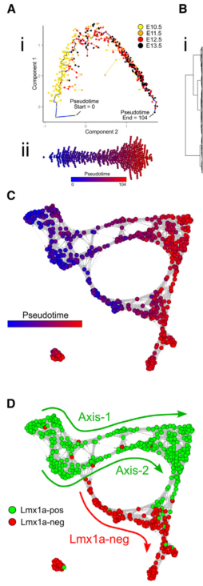
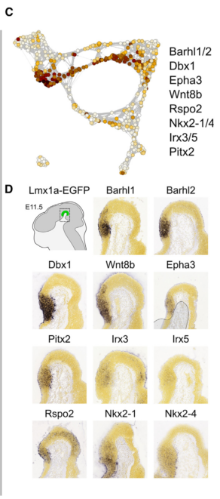
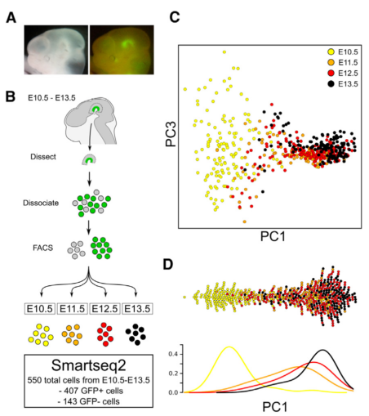
Kee et al. summary
ventral mesencephalic and diencephalic (VMD) region
Want to direct differentiation of hESCs into a pure population of mesencephalic dopamine (mesDA) neurons
Purpose: grafting in Parkinson’s disease
From Figure 1
From Figure 2
From Figure 3

Slide 3
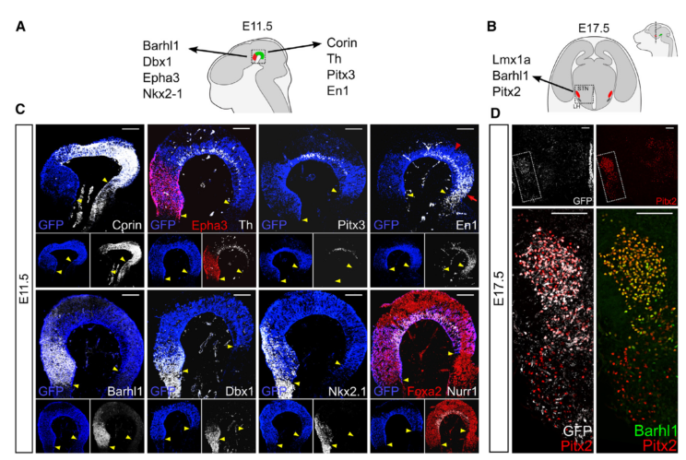
Kee et al. summary
Subthalamic nucleus (STN)
(glutamatergic)
mesDA (mesencephalic dopamine)
(dopaminergic)
From Figure 4

Slide 4
Setting up the data
25490-genes x 550-cells expression matrix in log2(RPKM + 0.001)
~79% sparse, only HQ cells publicly submitted
First removed genes that have 0 expression in >= 95% of samples
If, however, in the remaining 5% where expression was measured 90% of the expression values had > 0.01 RPKM, then keep the gene.
Expression matrix now 14571 x 550
Fit a linear model using EGFP expression and Embryonic day as covariates
E number was included as a categorical variable
Kept genes for which the model explained a significant proportion of variance (F-test, p-val < 1/14571 = 6.8629e-05)
Expression matrix now 5785-genes x 550-cells

Slide 5
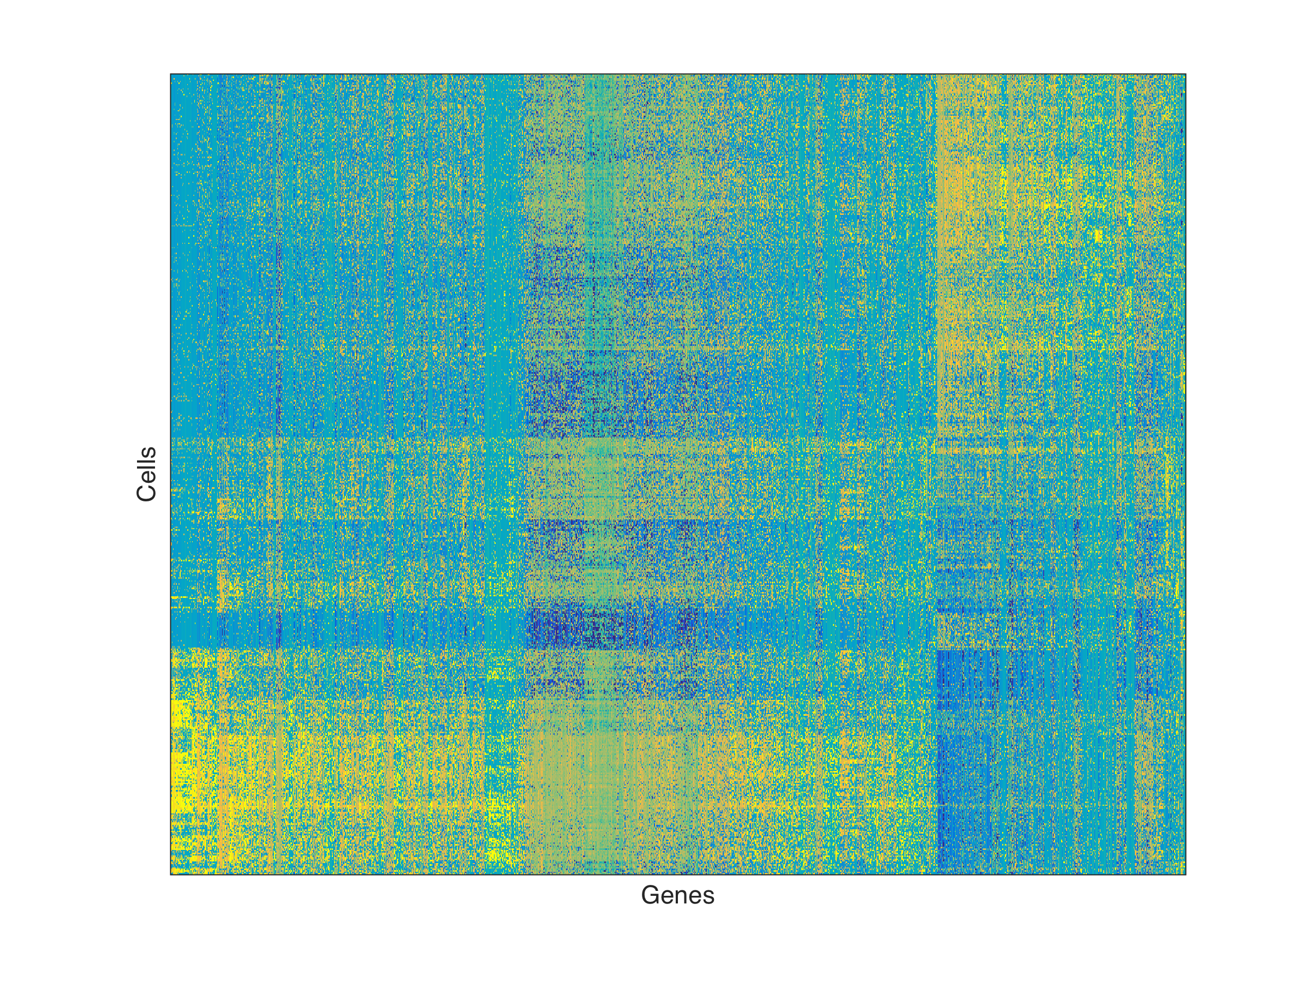
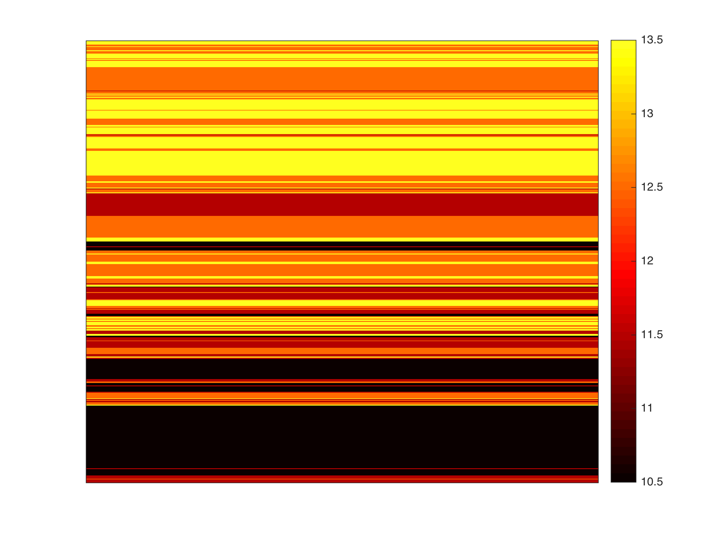
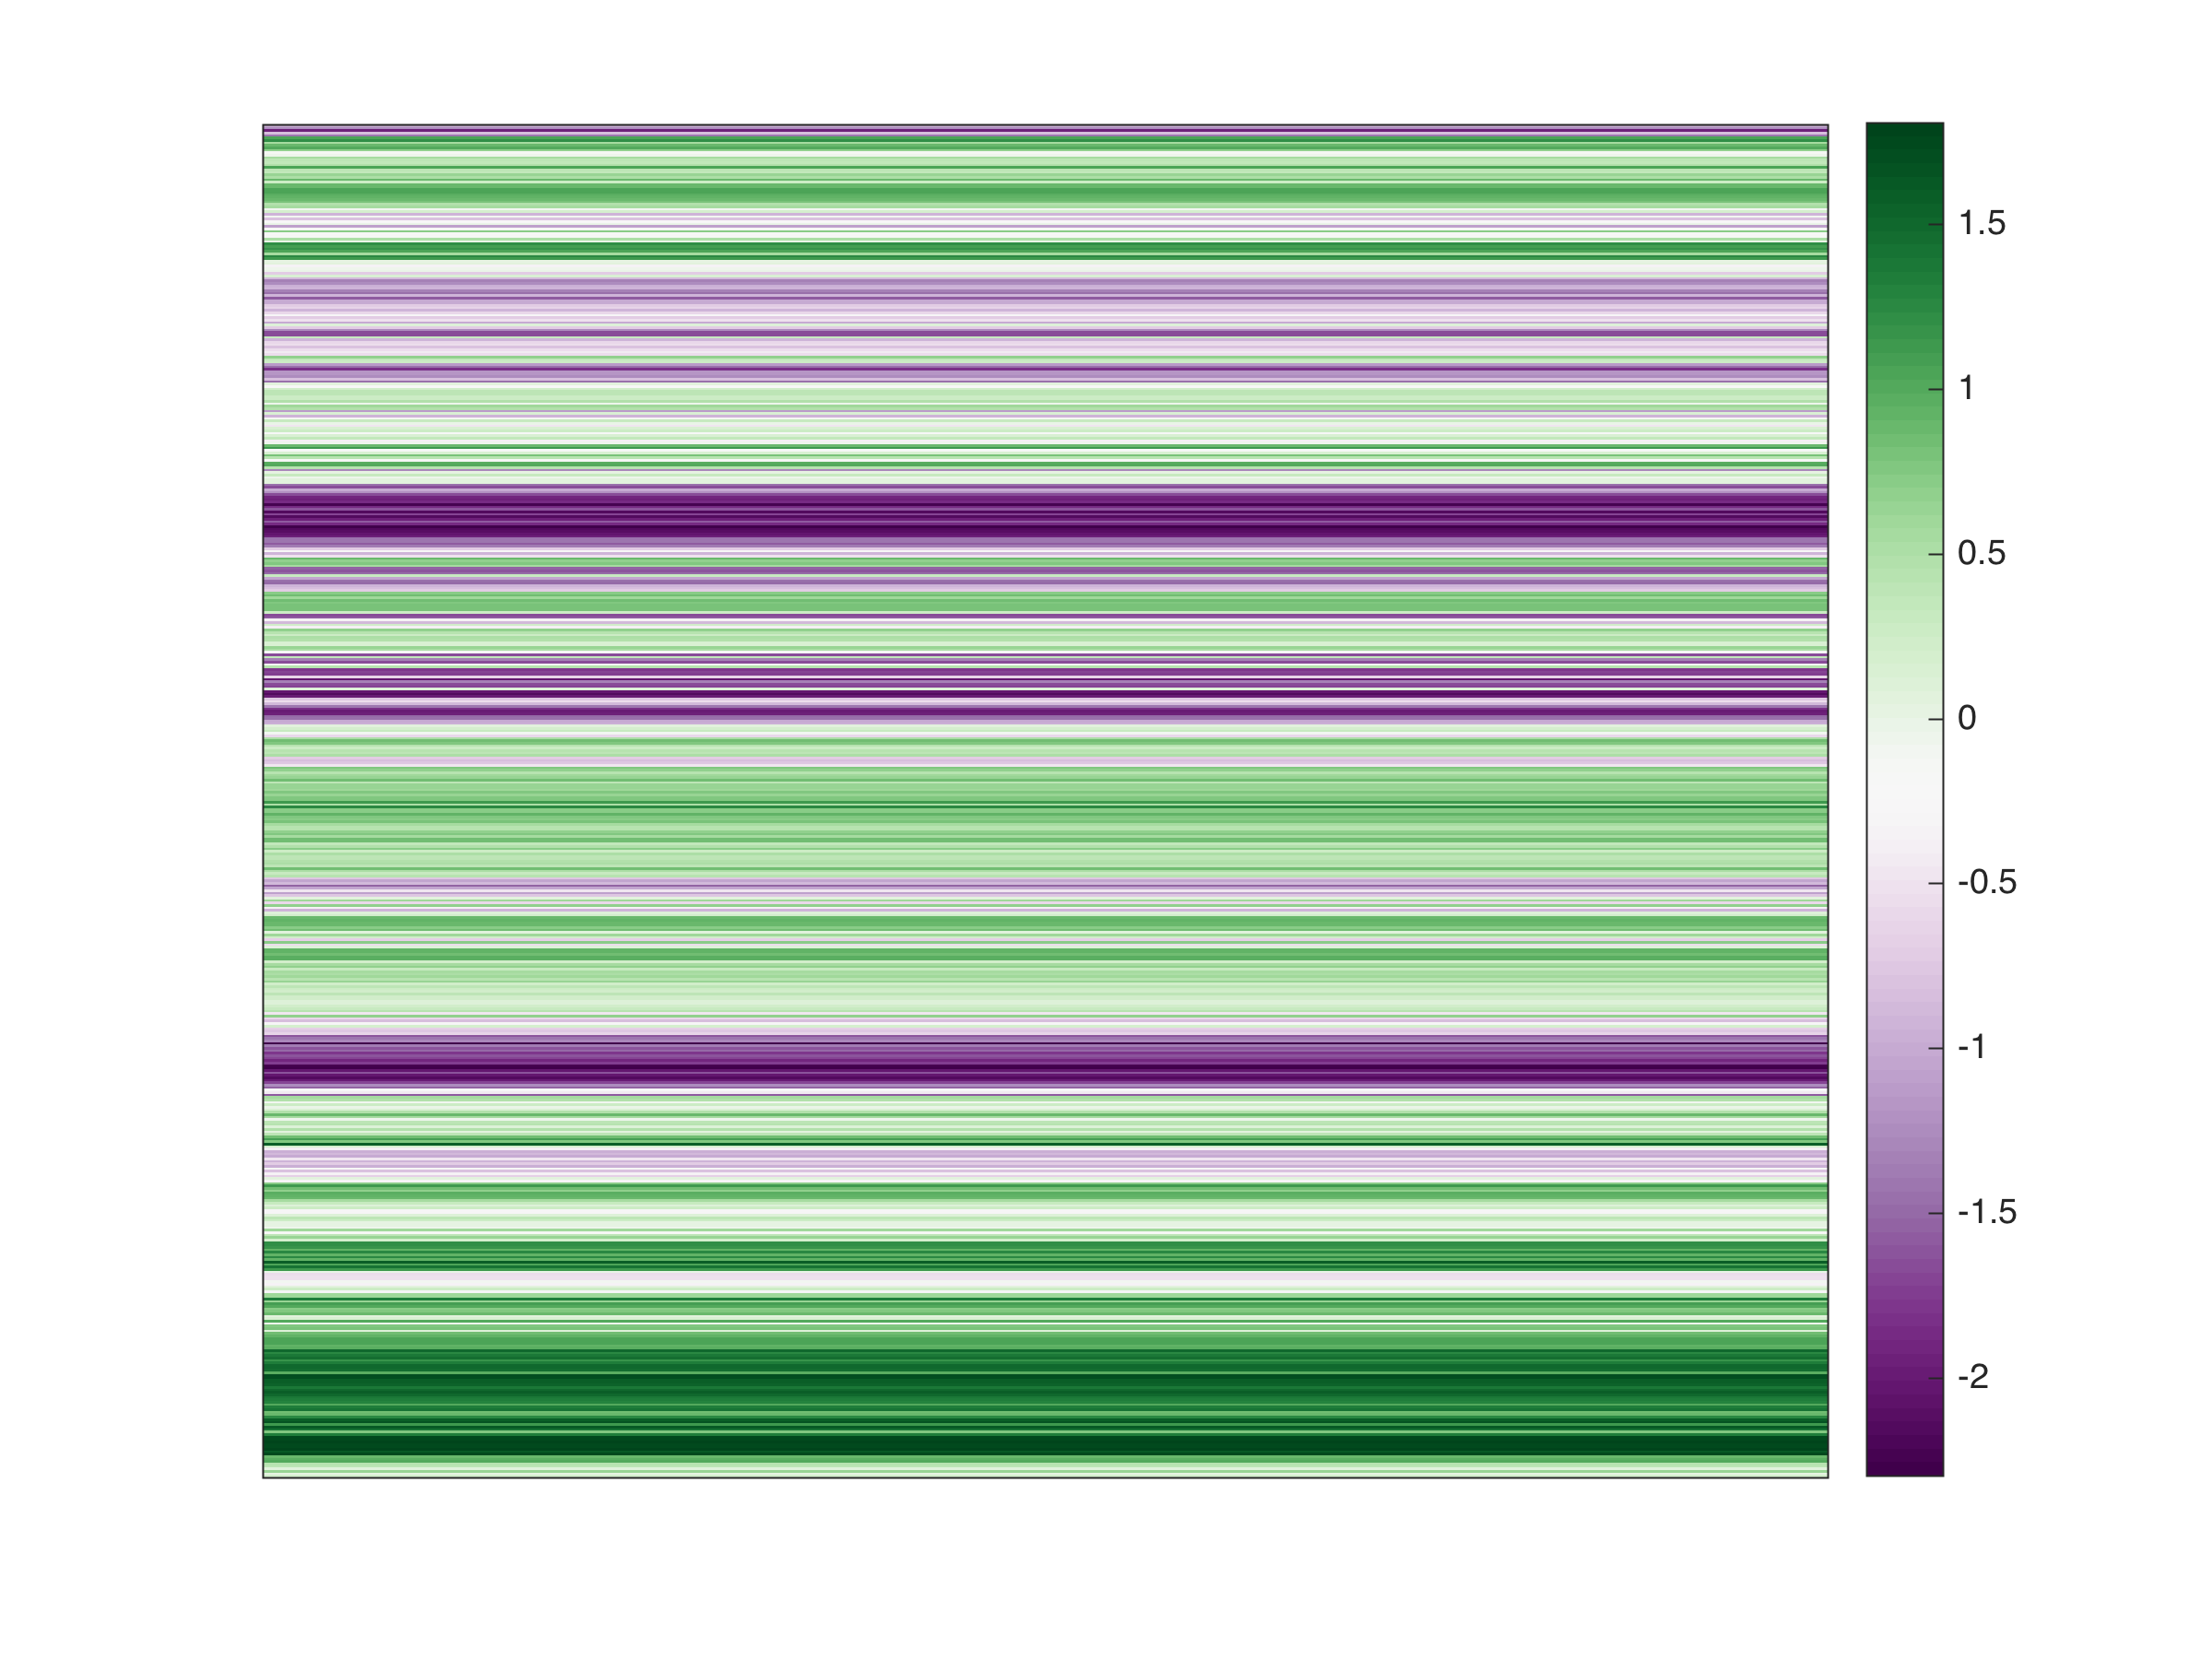
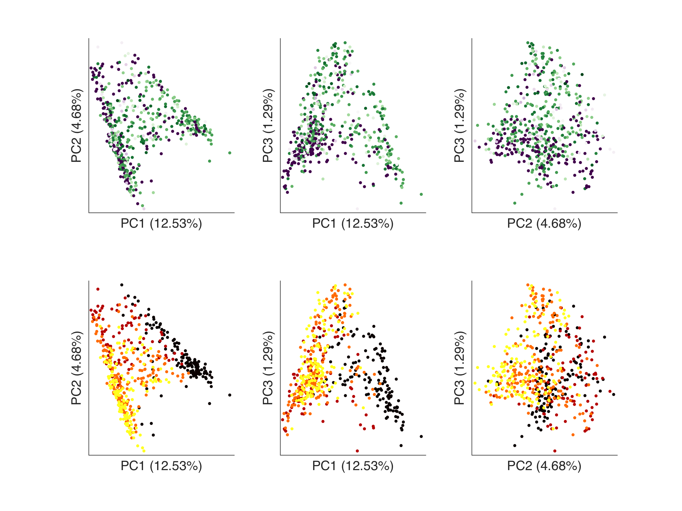
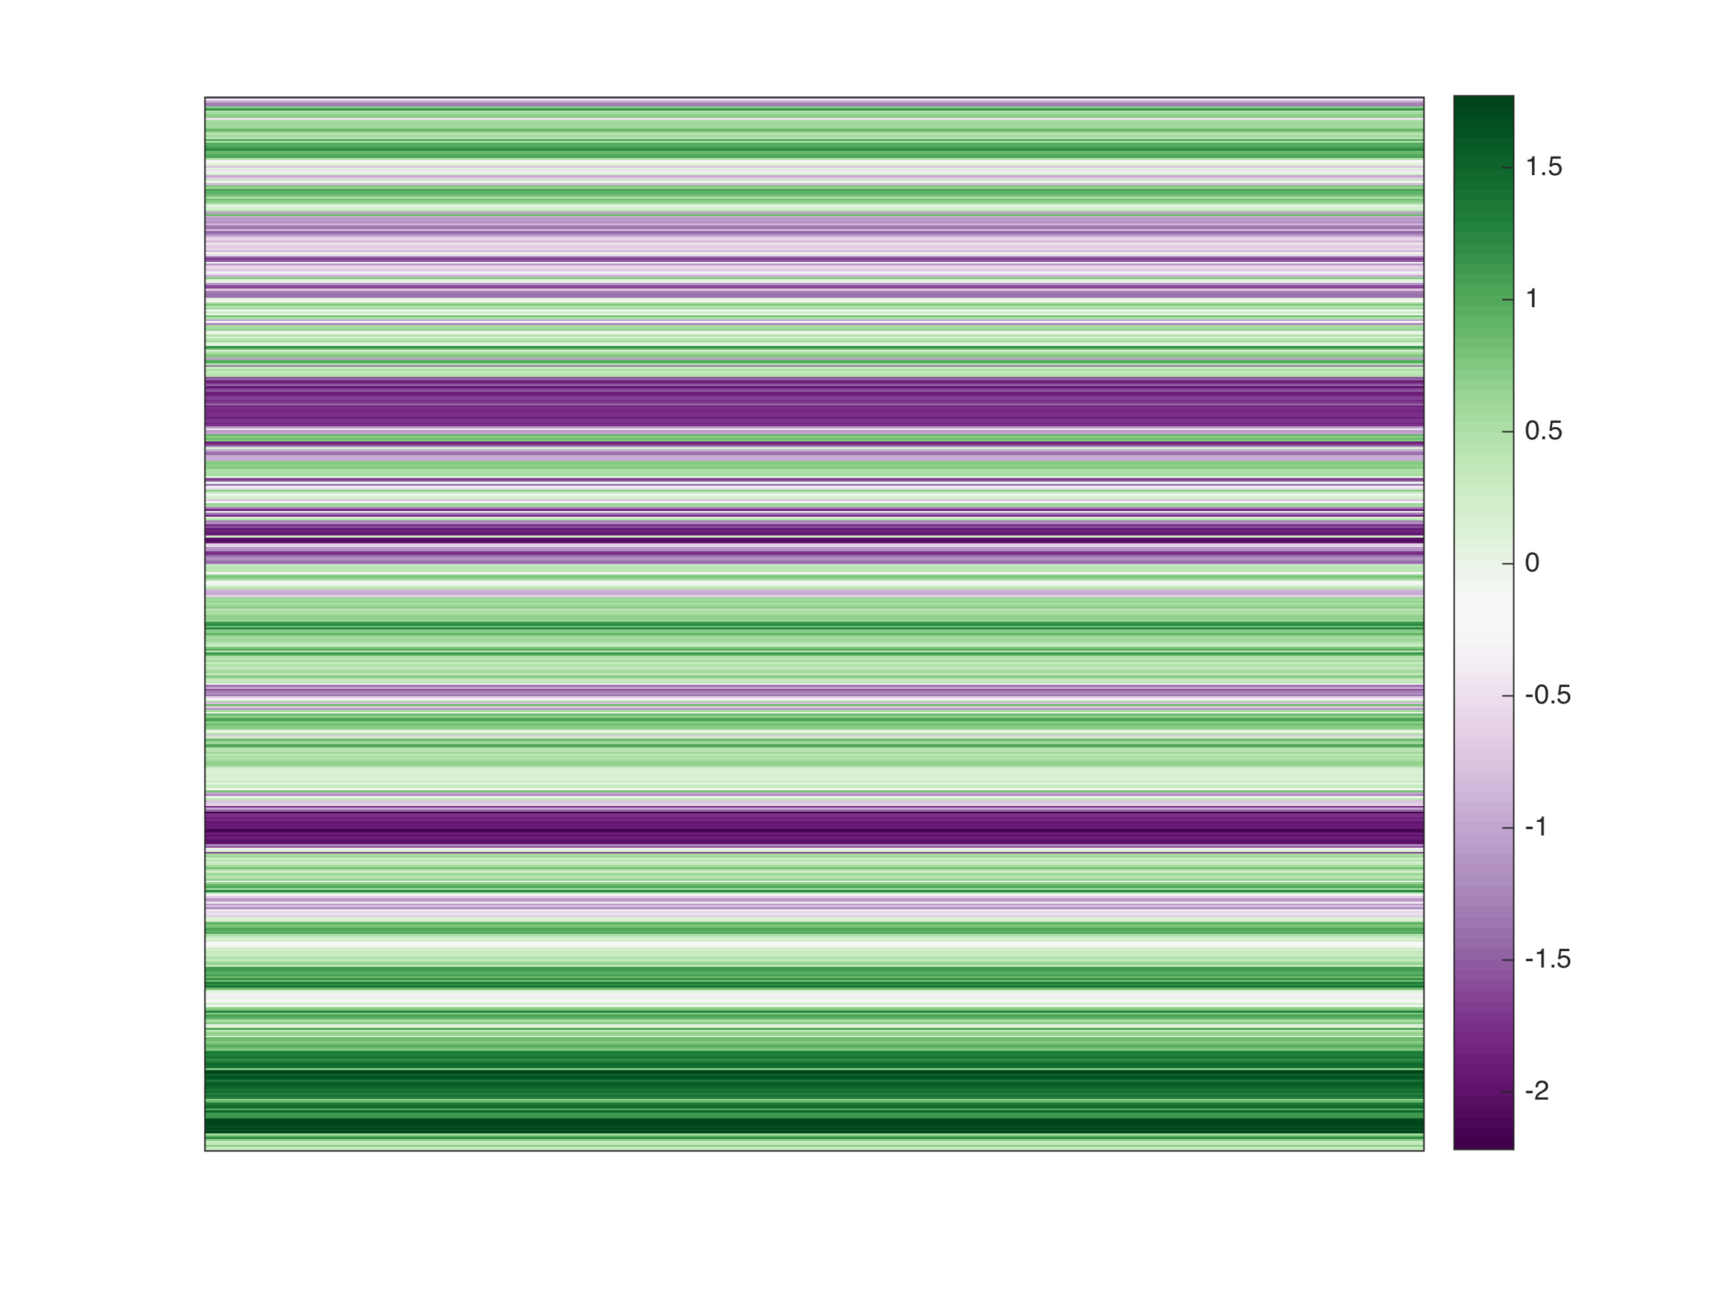
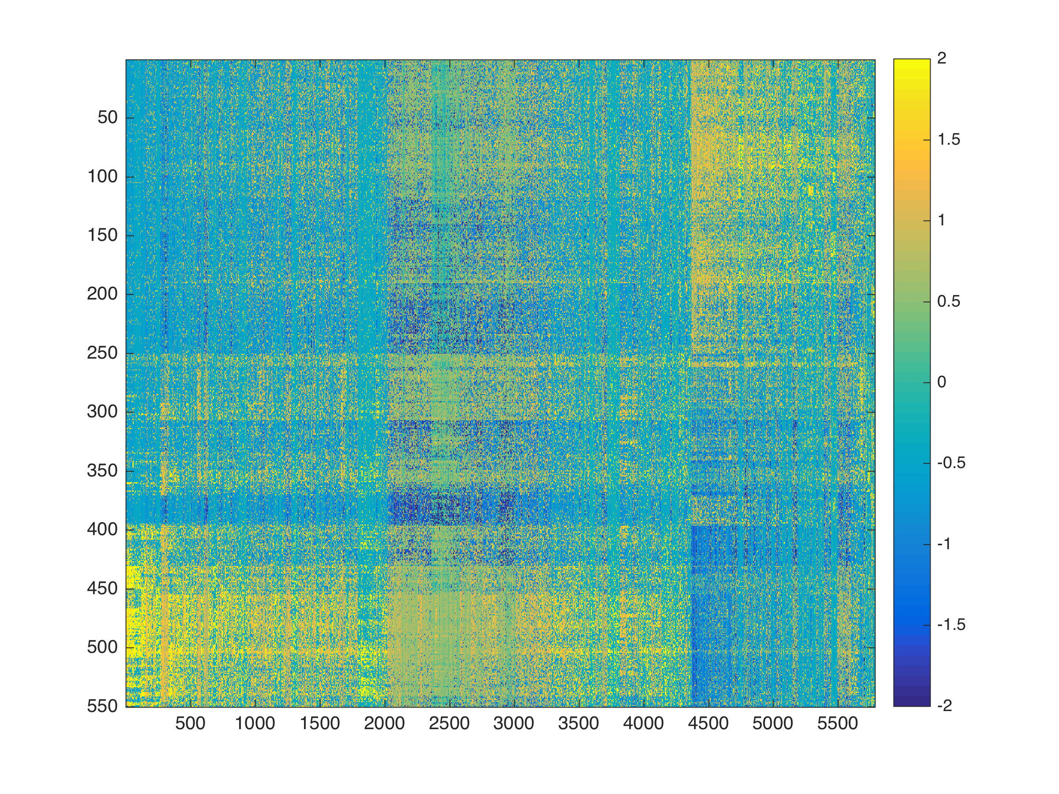
Exploratory analysis
E day
E day
Lmx1a
Lmx1a expression z-score
expression z-score (standardized log2(RPKM + 0.001))

Slide 6
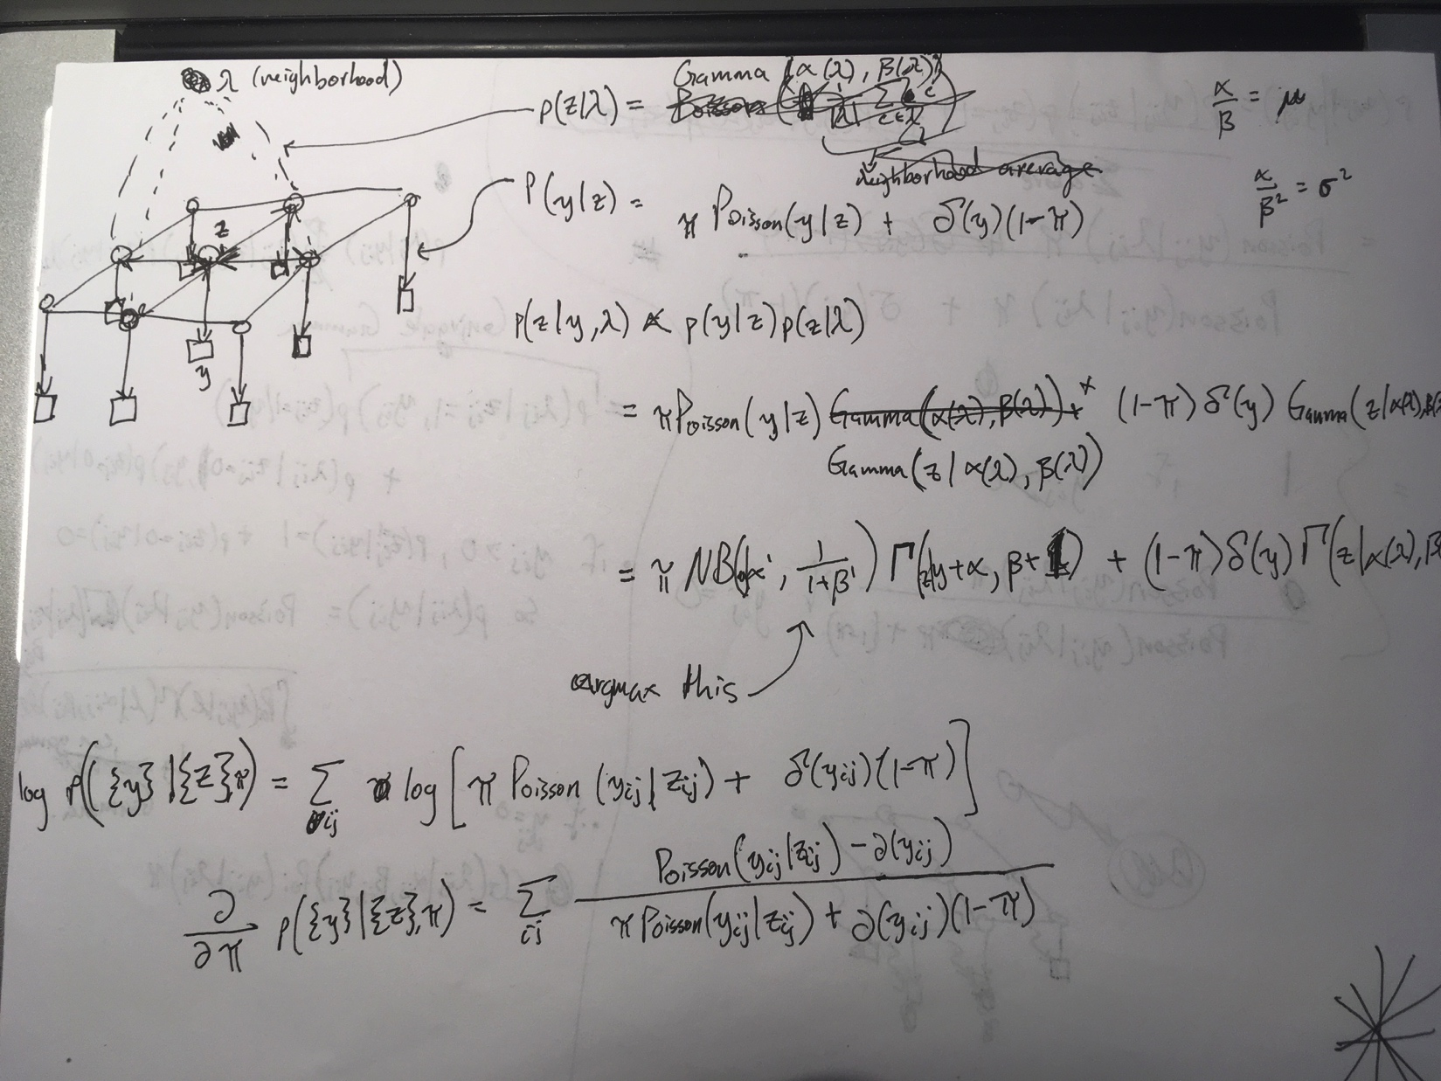
Imputation?
Markov Random Field
E day
E day
Lmx1a
Lmx1a expression z-score
expression z-score (standardized log2(RPKM + 0.001))

Slide 7
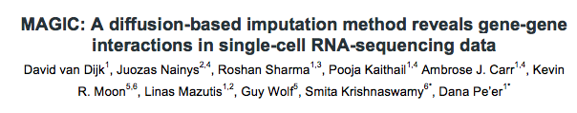
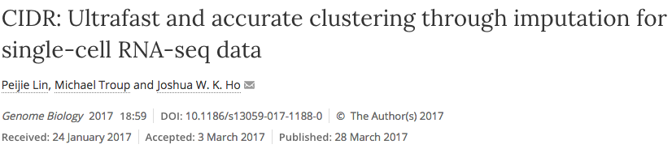
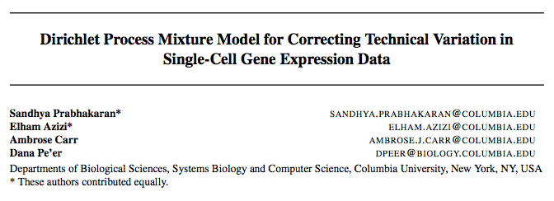
Imputation?
E day
E day
Lmx1a
Lmx1a expression z-score
expression z-score (standardized log2(RPKM + 0.001))

Slide 8
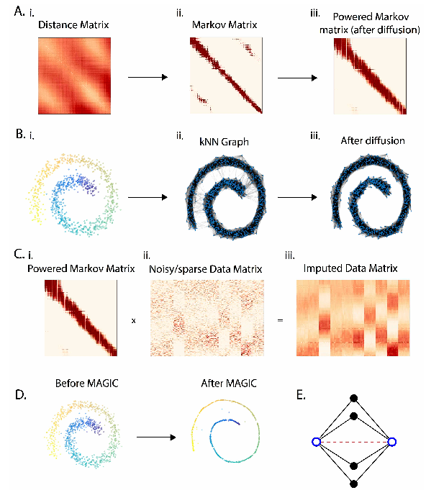
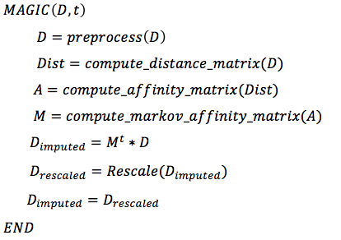
Imputation?
E day
E day
Lmx1a
Lmx1a expression z-score
expression z-score (standardized log2(RPKM + 0.001))

Slide 9
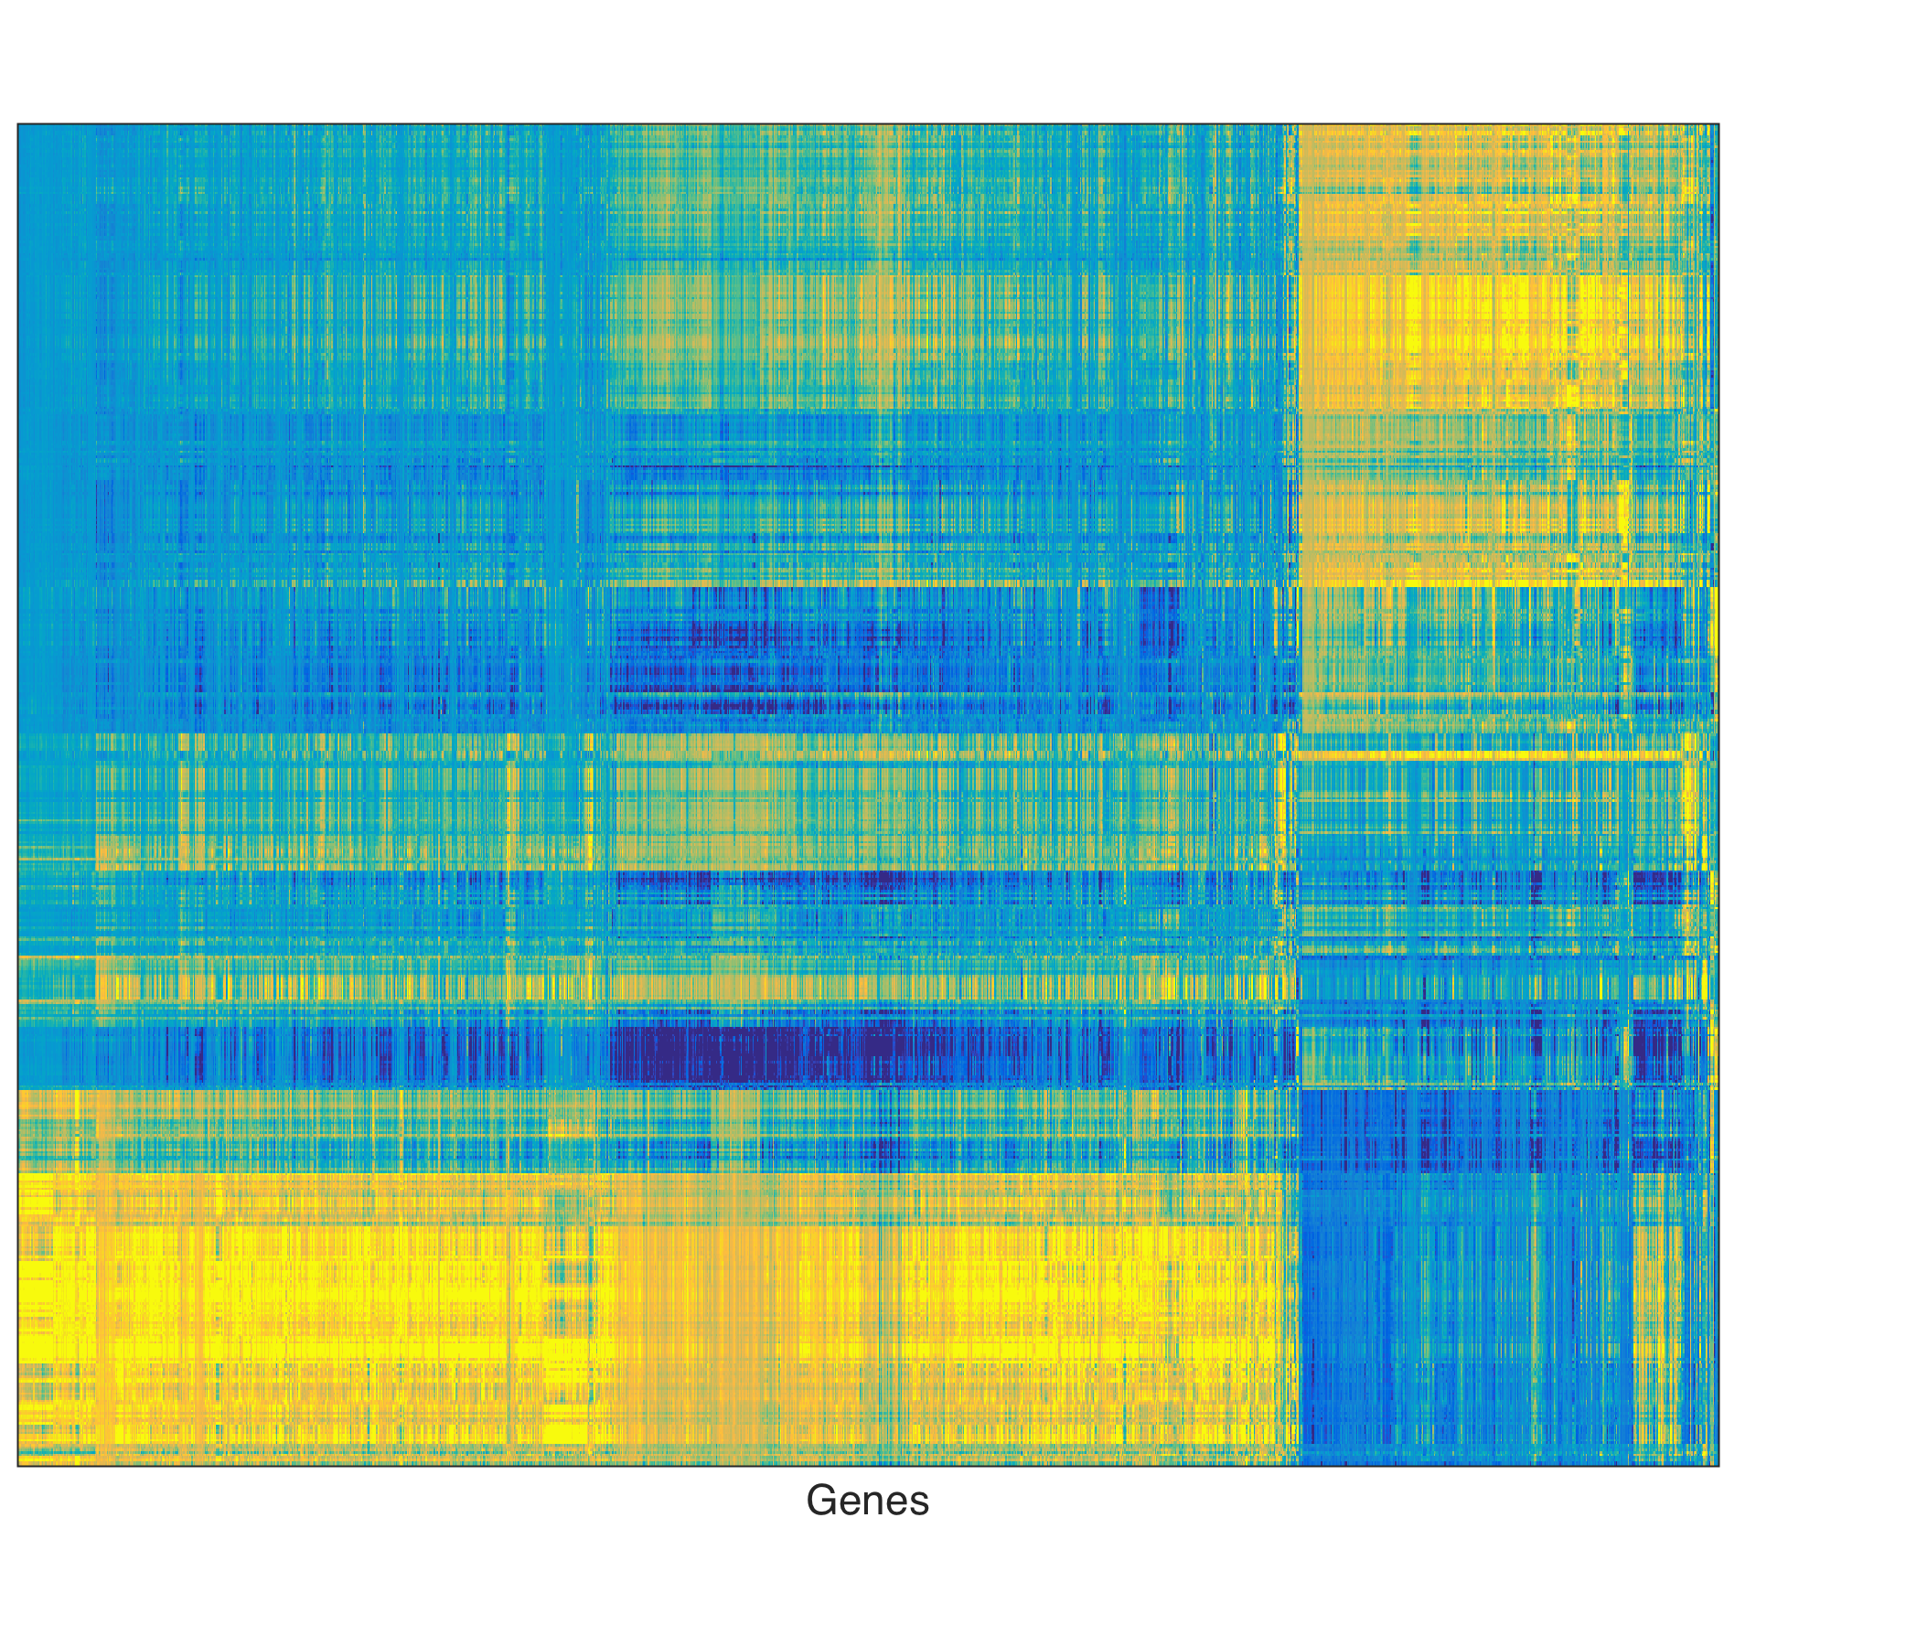
Imputation?
Original
Imputed
E day
E day
Lmx1a
Lmx1a expression z-score
expression z-score (standardized log2(RPKM + 0.001))

Slide 10
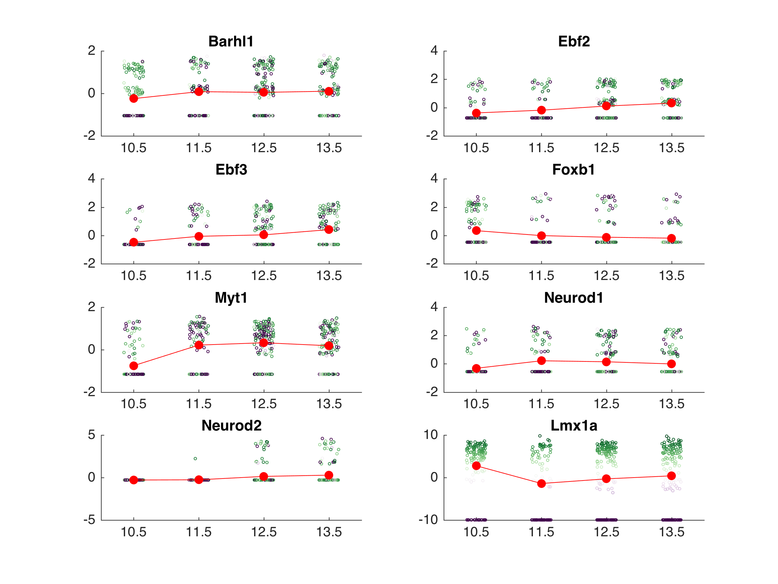
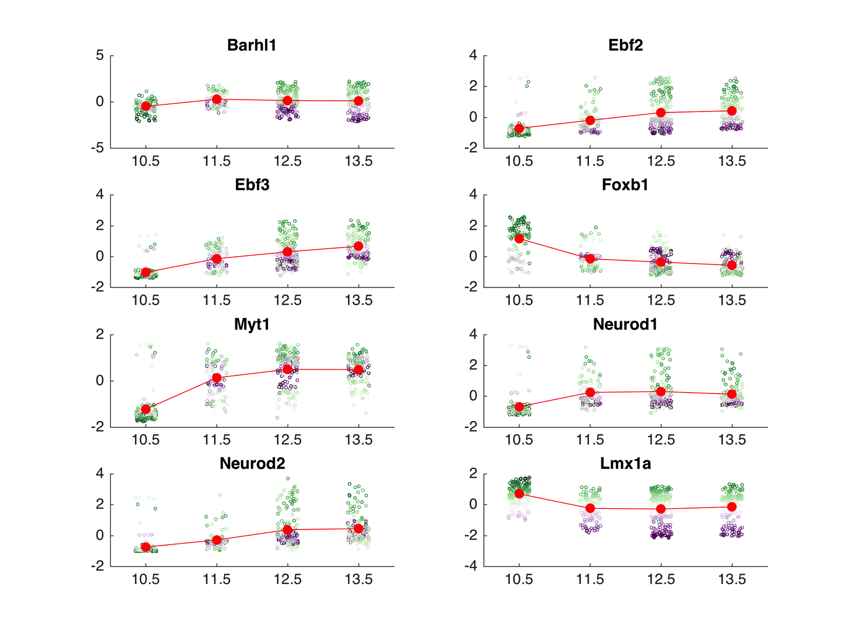
Imputation?
original expression
imputed expression
Lmx1a expression z-score

Slide 11
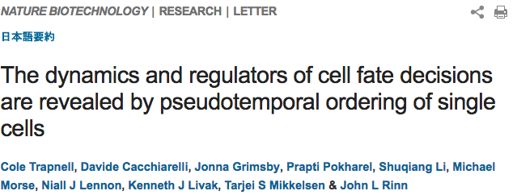
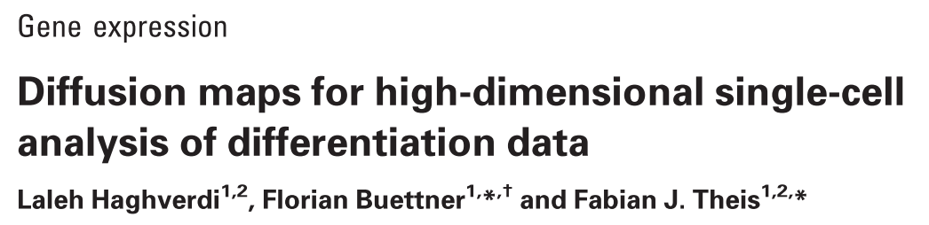

Pseudotime trajectories
Monocle
Destiny
Monocle2

Slide 12
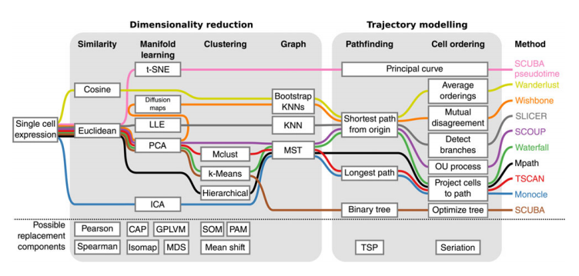
Pseudotime trajectories
Taken from Cannoodt et al. European Journal of Immunology (2016).

Slide 13
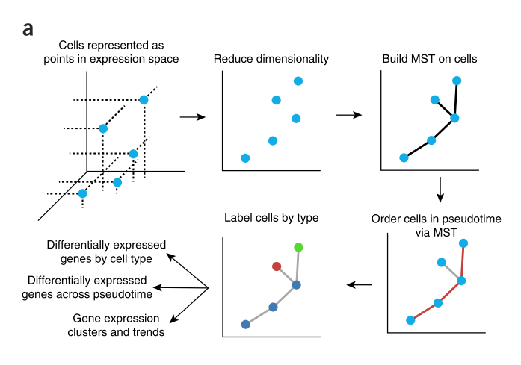
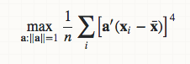
Monocle
ICA objective

Slide 14
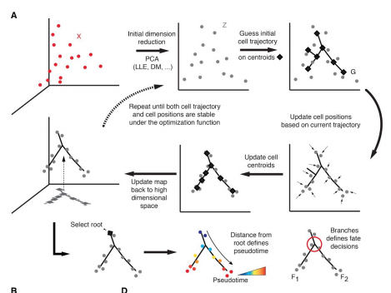
Monocle 2

Slide 15
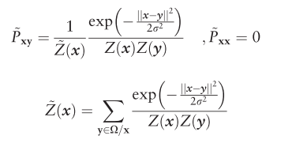
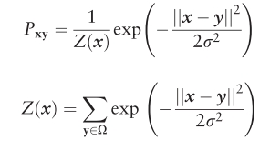
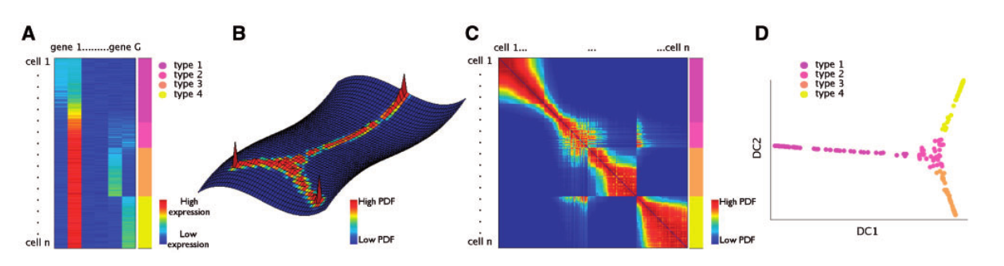
Diffusion

Slide 16
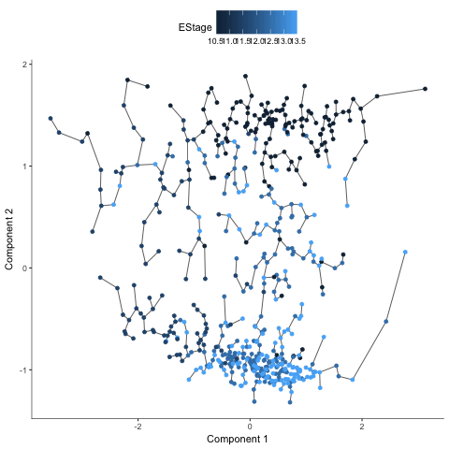
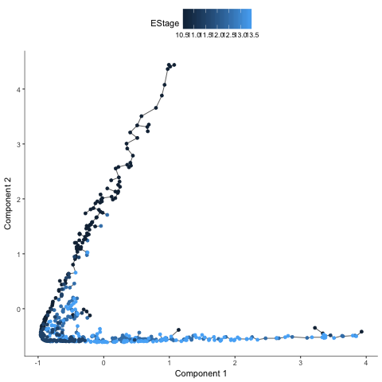
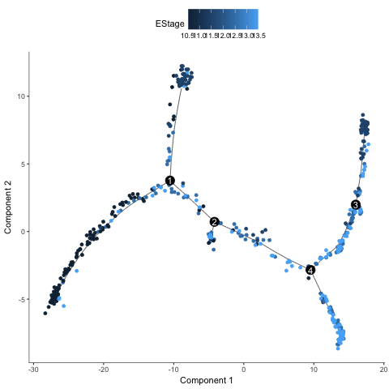
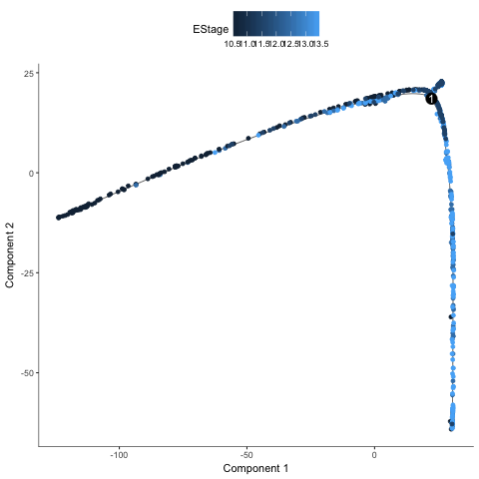
Monocle
expression matrix
Original
Imputed
Monocle
Monocle2

Slide 17
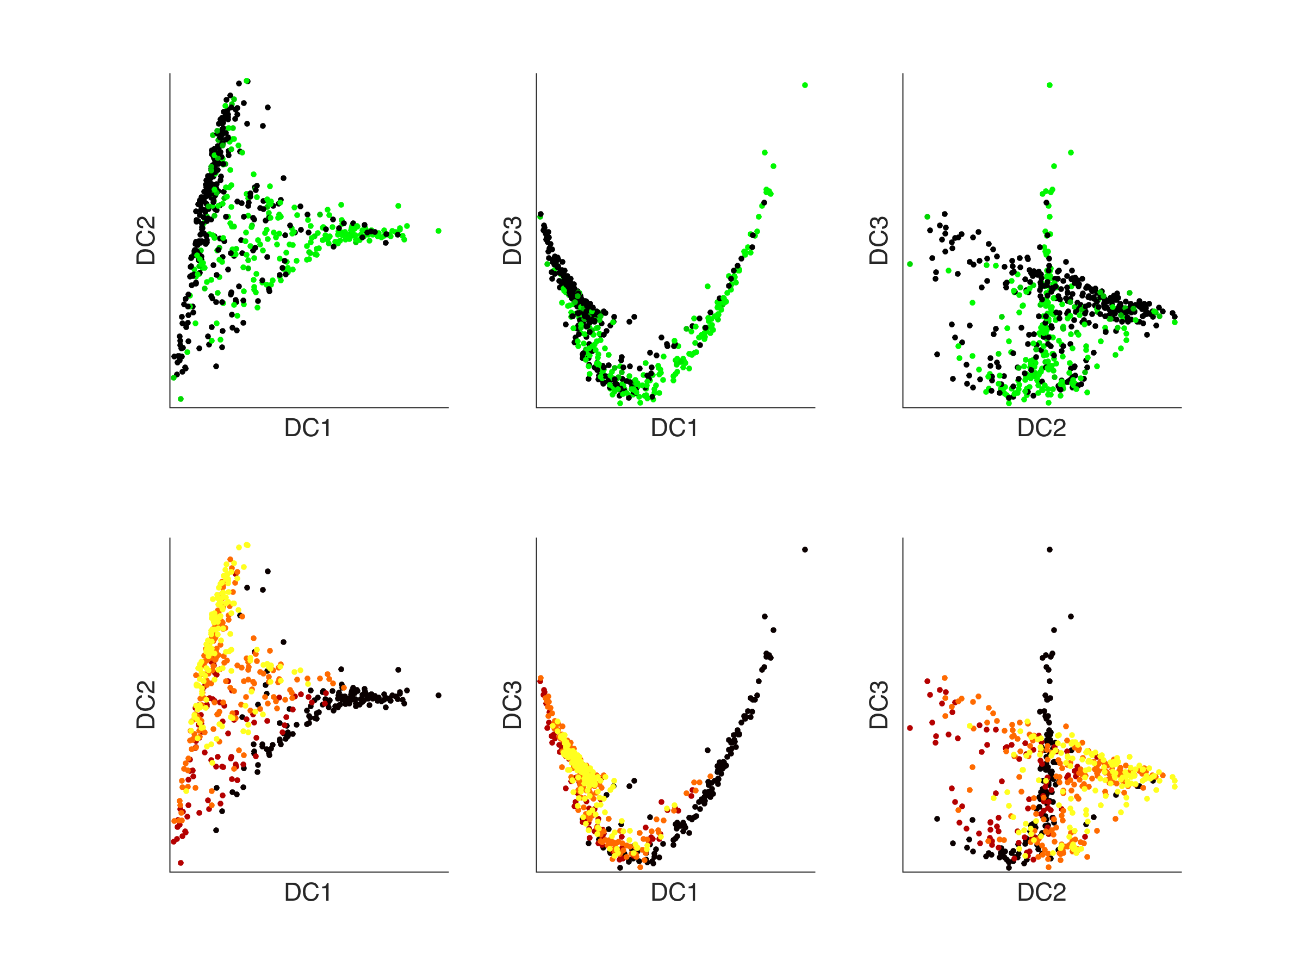
Destiny (diffusion)
% 3D trajectories
openfig('~/GitHub/pqe/figures/Diffusion_plot_imputed_expression_matrix.fig')
openfig('~/GitHub/pqe/figures/Diffusion_plot_imputed_expression_matrix_Enum.fig')
E day
Lmx1a expression z-score

Slide 18
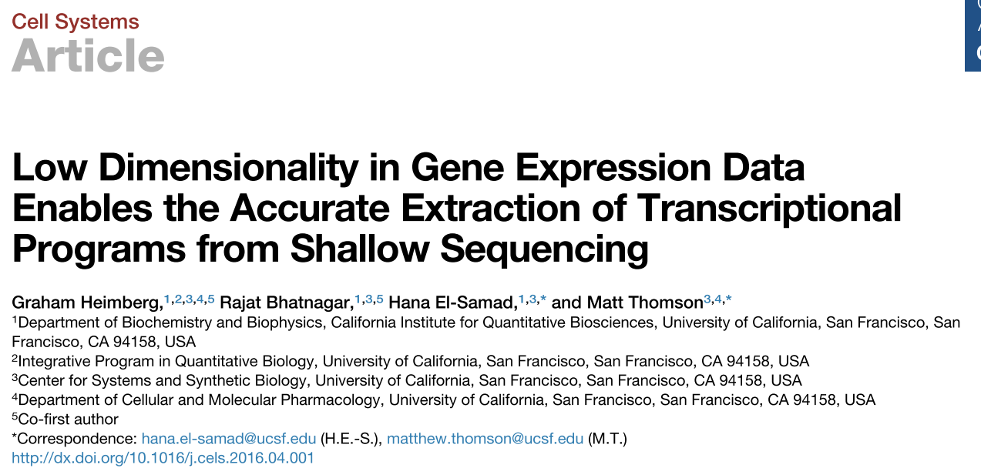
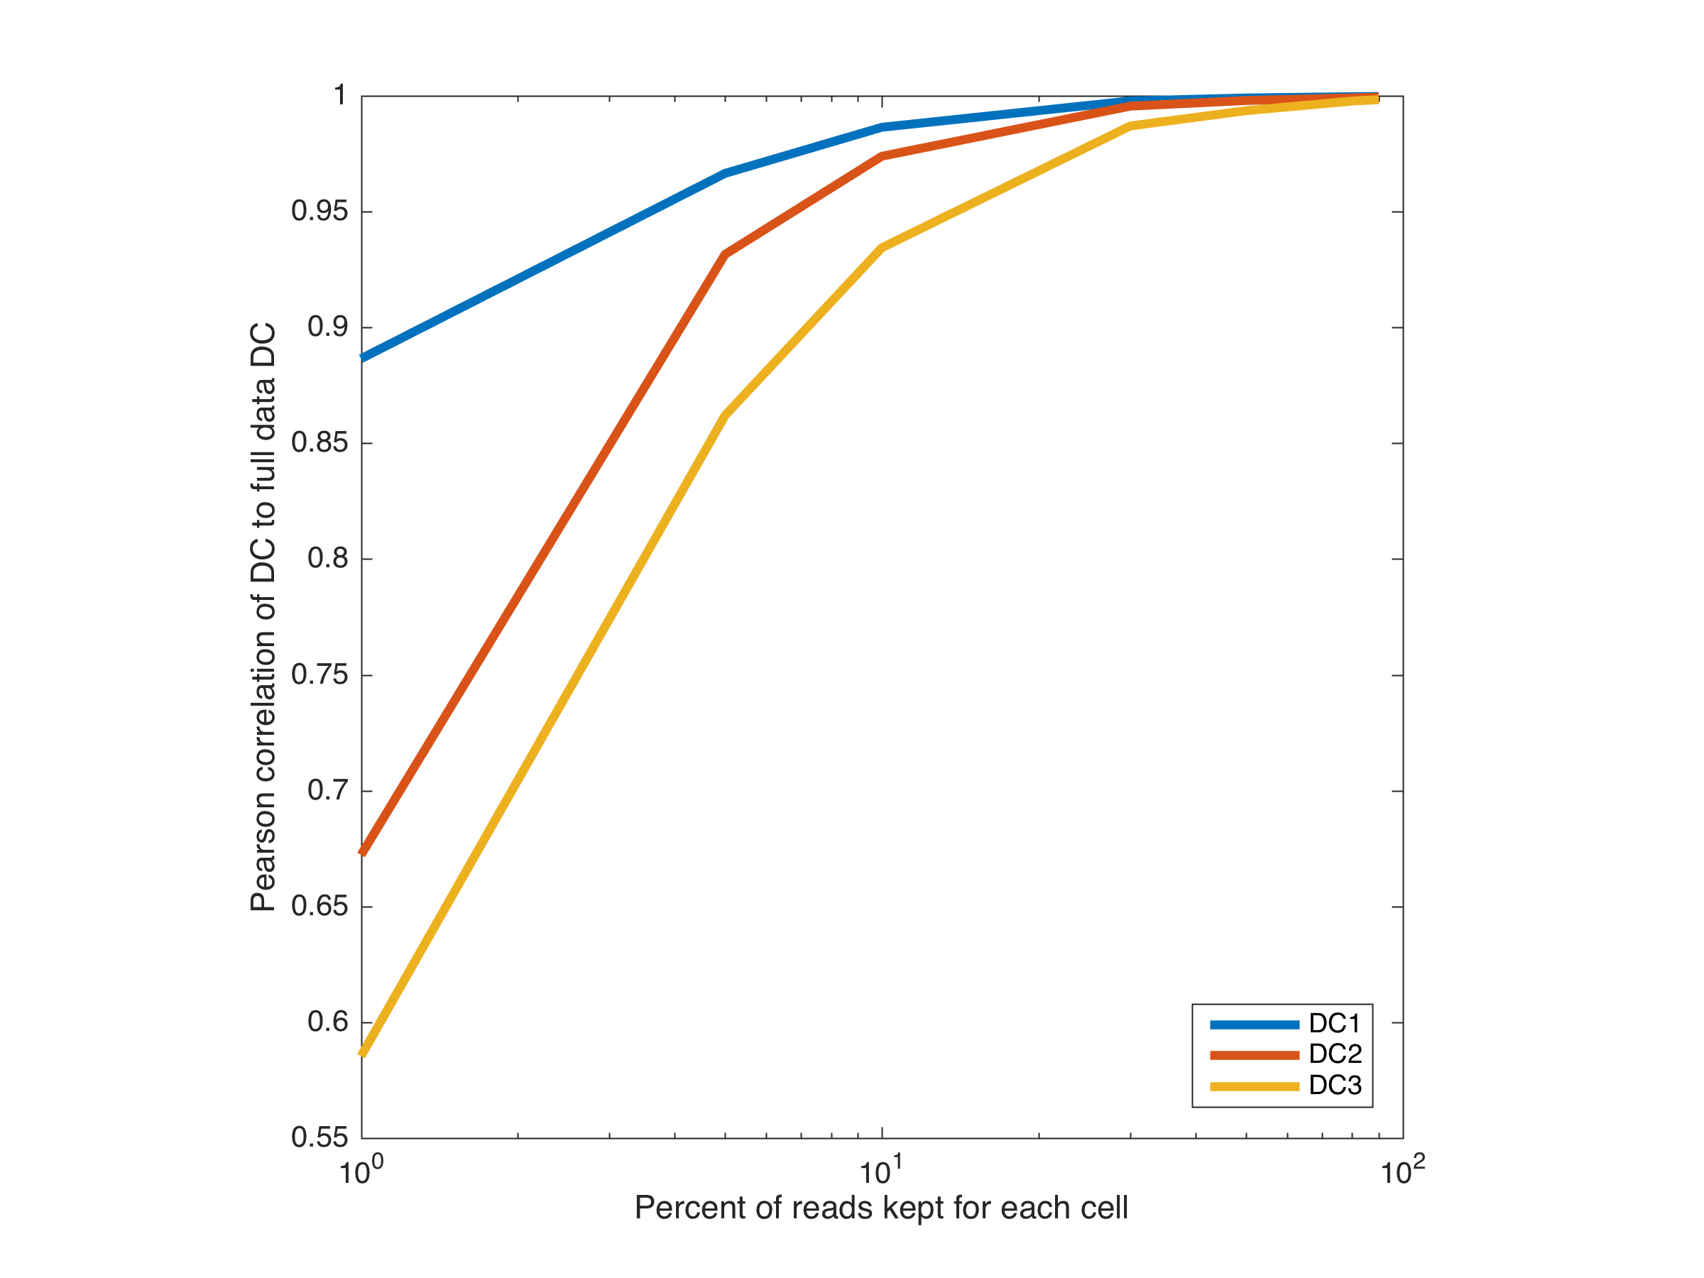
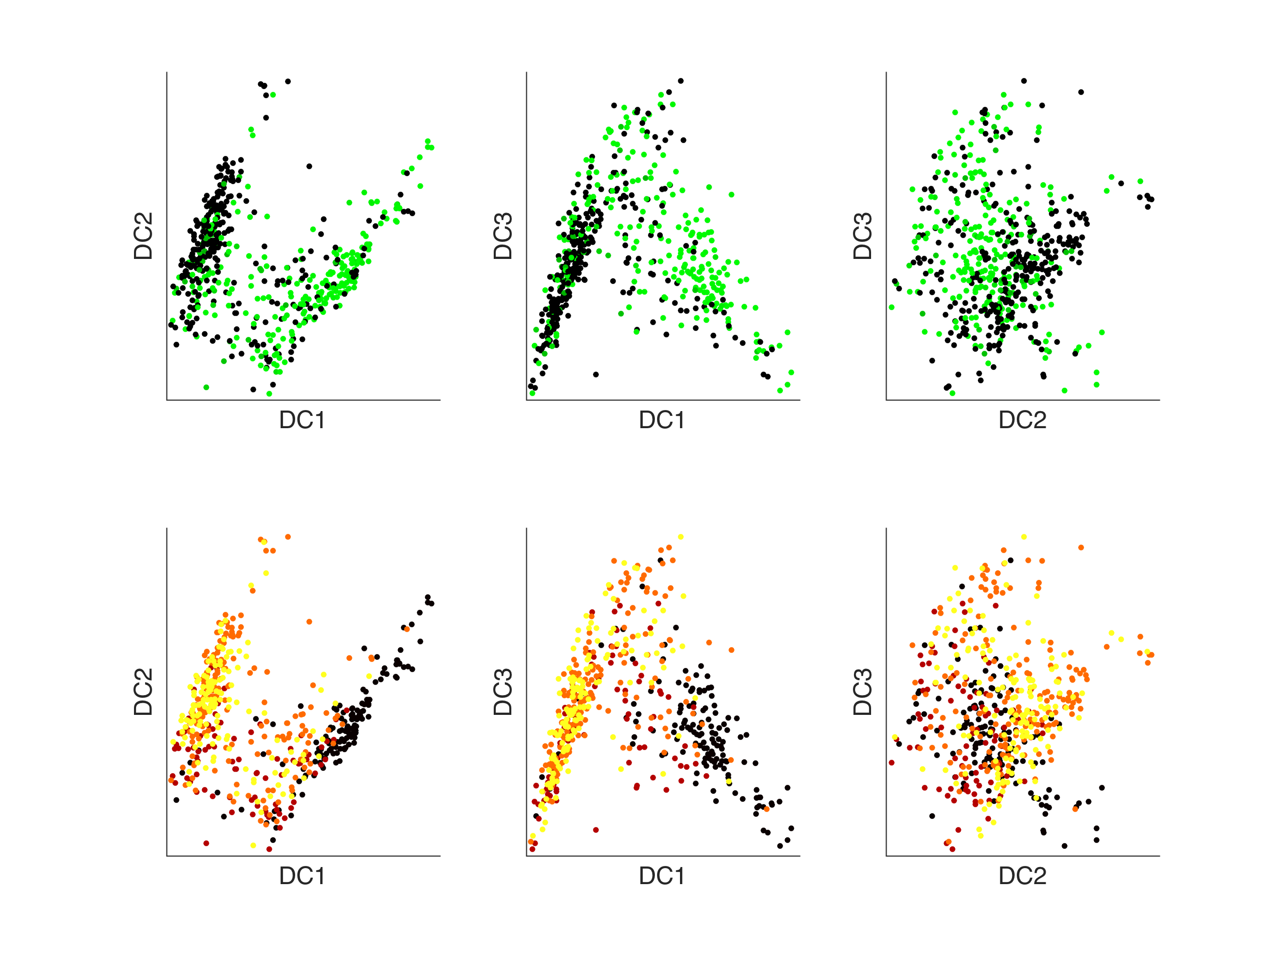
How does sequencing depth influence estimated trajectories?
100% depth
1% depth

Slide 19
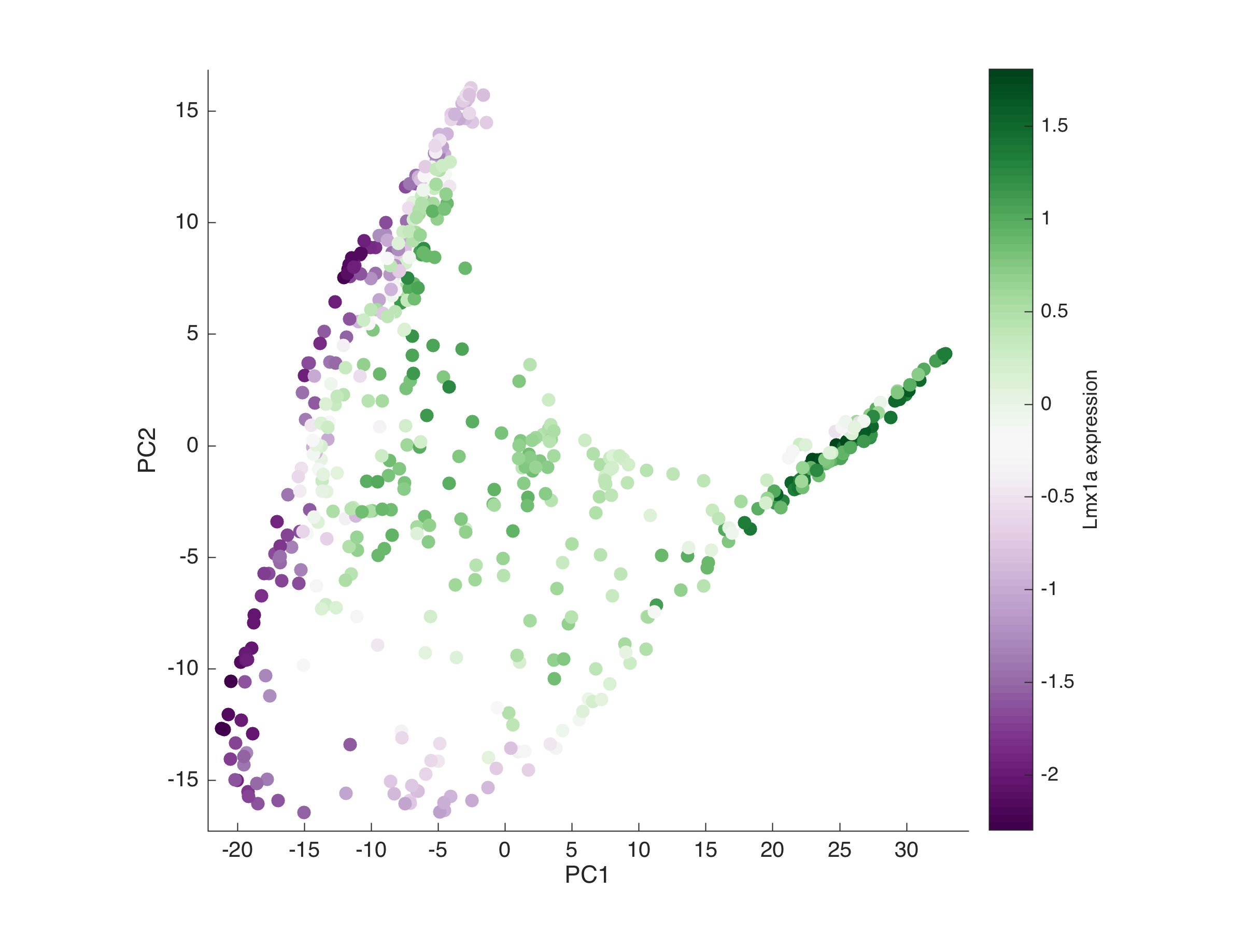
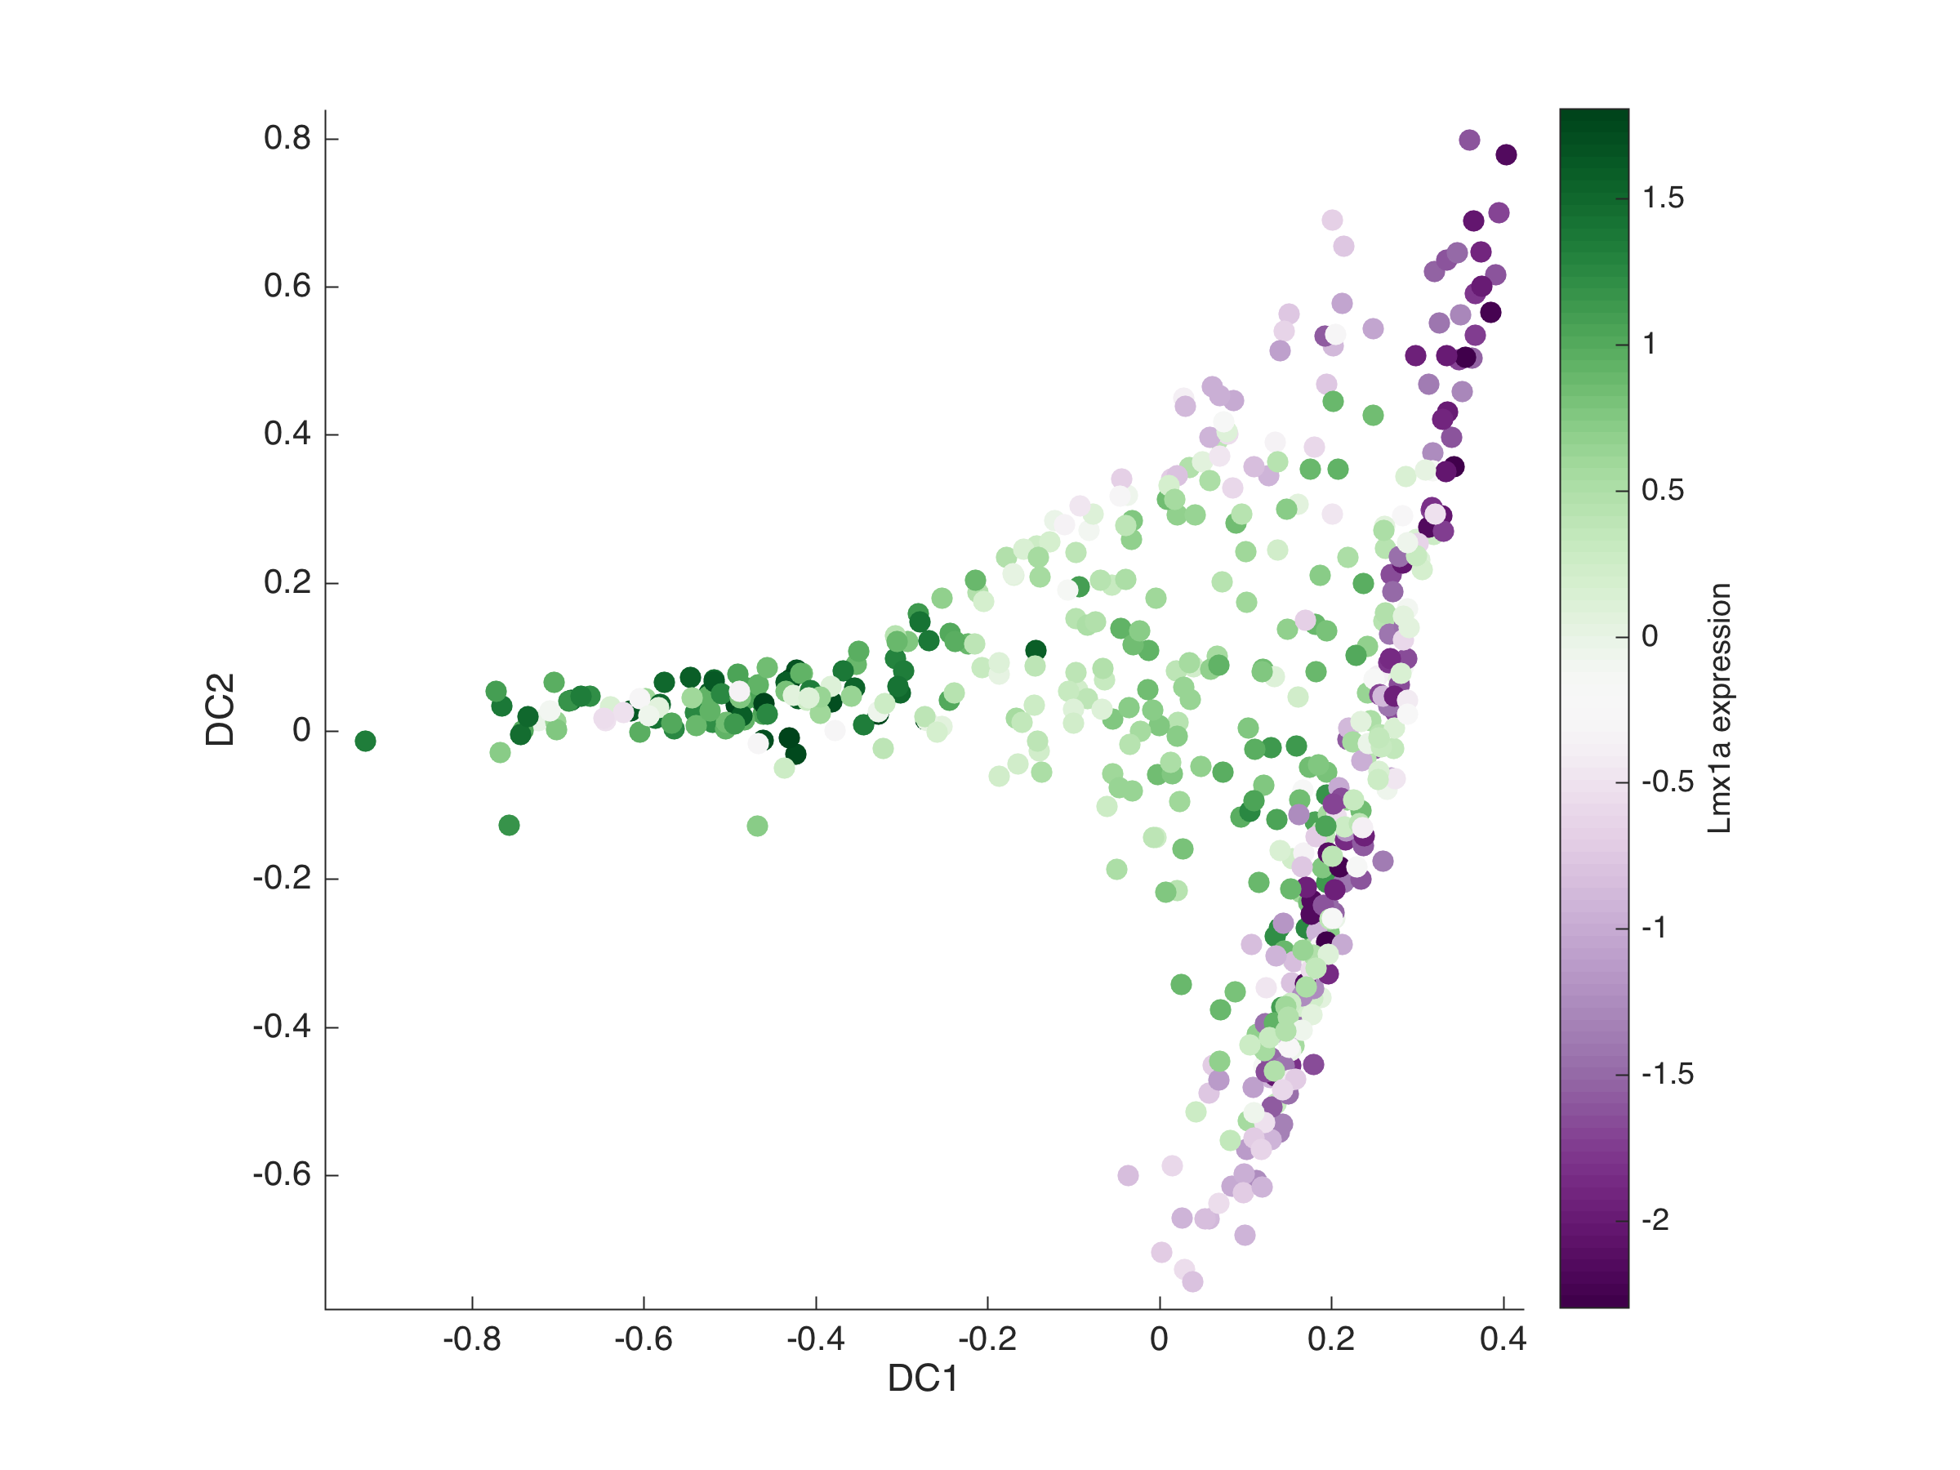
Diffusion trajectories
PCA
Diffusion (Destiny)

Slide 20
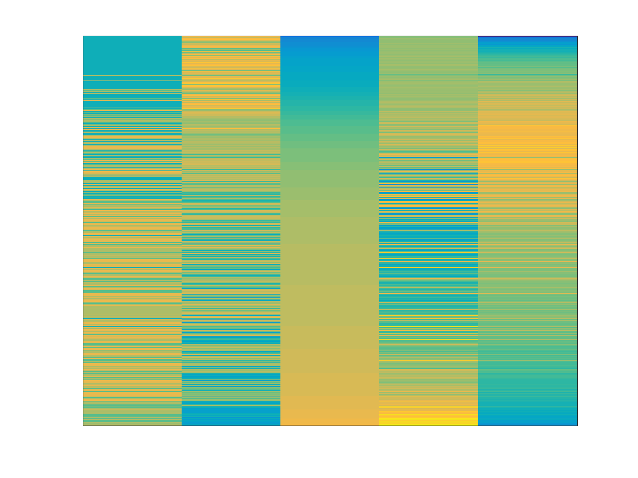
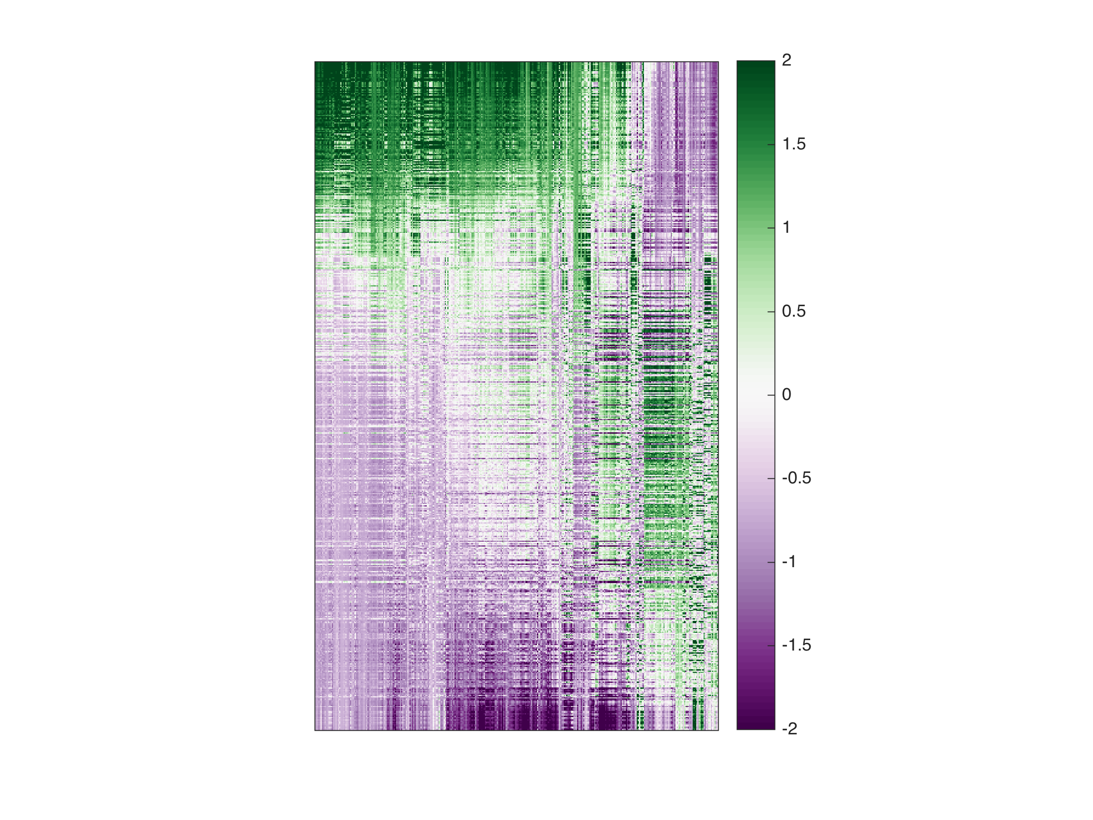
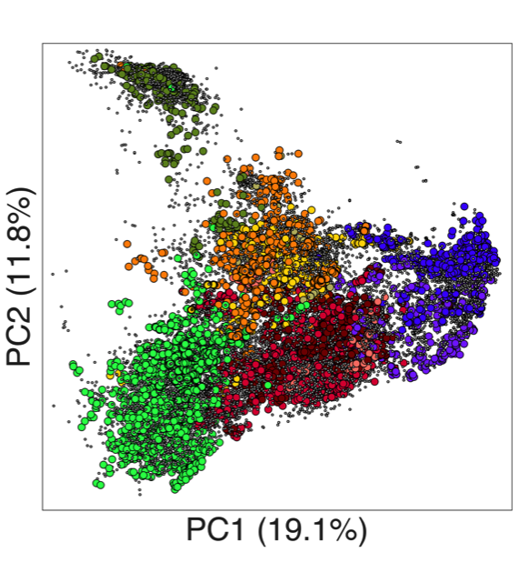
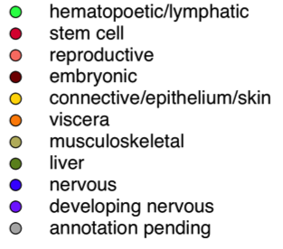
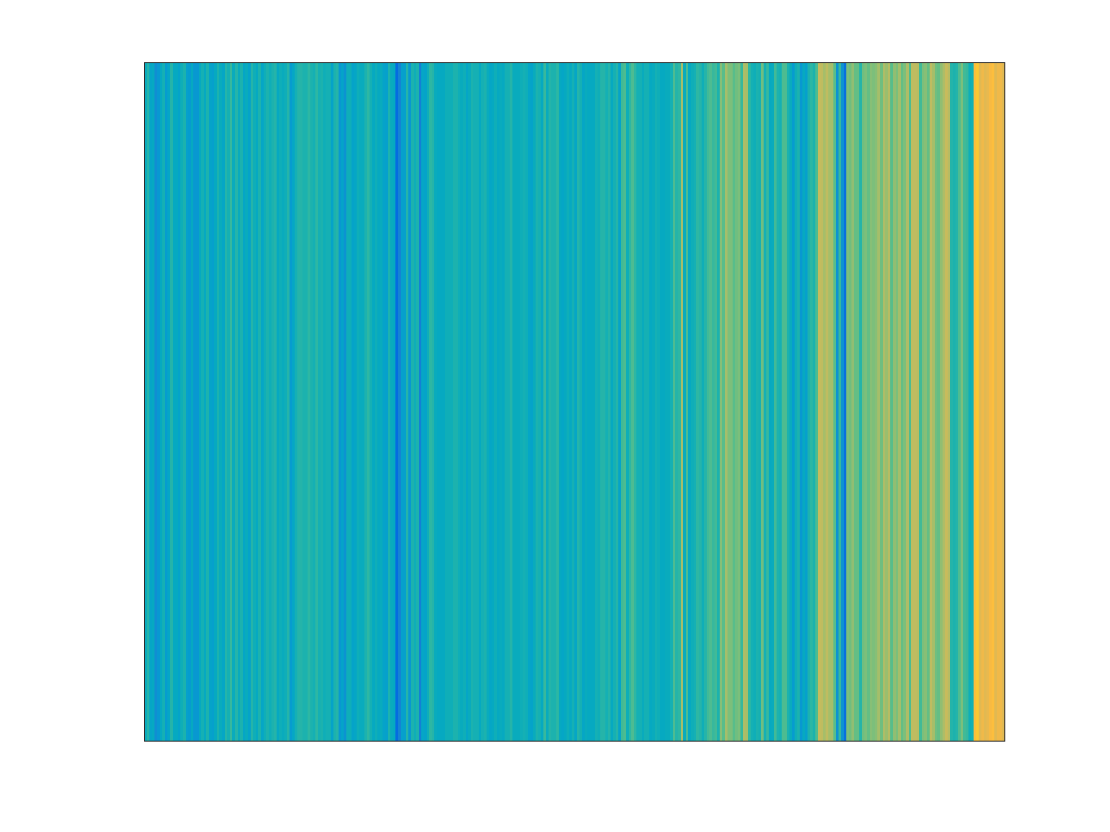
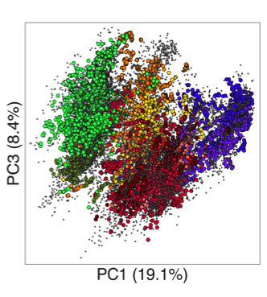
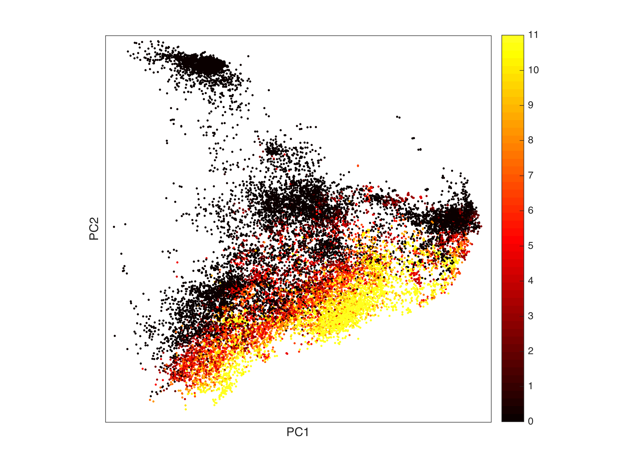
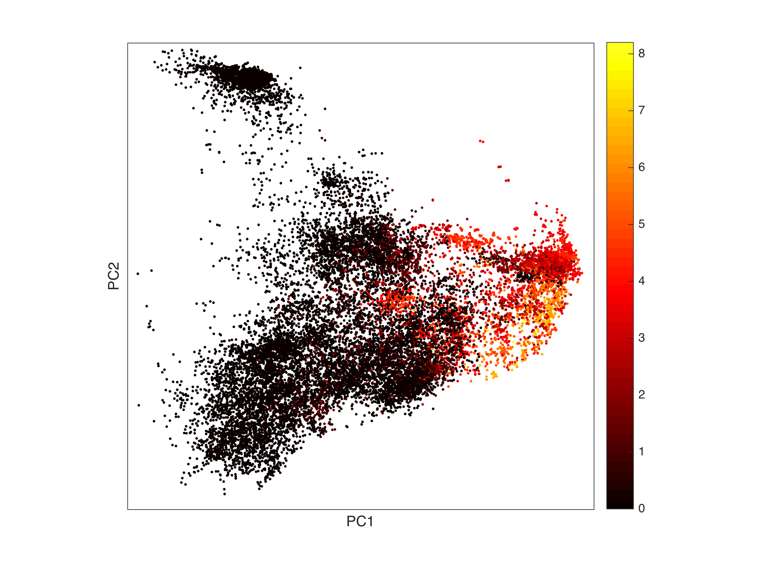
E_stage
Lmx1a
DC1
DC2
DC3
Spearman corr to Lmx1a x DC1
Barhl1
Ebf2
Ebf3
Foxb1
Myt1
Neurod1
Neurod2
Nhlh1
Nhlh2
Nr4a2
Pitx2
Pitx3
Sim1
St18
Taf6l
Cells
Taken from: Biswas et al. Tradict enables accurate prediction of eukaryotic transcriptional states from 100 marker genes. Nat. Comms. (2017). In Press.
All TF signature
Lmx1a x DC1 TF signature
signature score
signature score
TFs

Slide 21
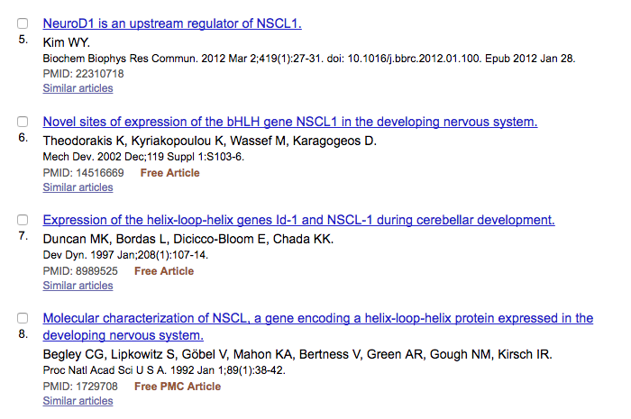
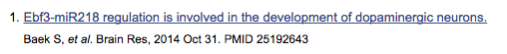
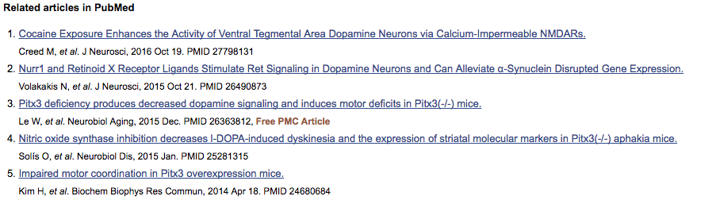
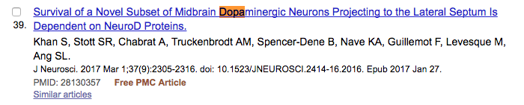
Nhlh1 (Nscl1)
Nhlh2
Nr4a2 (Nurr1)
Pitx2
Pitx3
Sim1
St18
Taf6l
Barhl1
Ebf2
Ebf3
Foxb1
Myt1
Neurod1
Neurod2

Slide 22
Conclusions
Imputation simplifies trajectory reconstruction
Distinct methods produce similar results
Imputation stabilizes trajectory reconstruction and reduces uncertainty
Read depth does not strongly influence trajectory reconstruction
A a generalizable neural differentiation TF signature of 15 TFs could be extracted from the Kee et al. data

Slide 23

No obvious “Axis 2” signature
a2genes = {'Barhl1', 'Barhl2', 'Dbx1', 'Epha3', 'Wnt8b', 'Rspo2', 'Pitx2'};
[~,a2s] = pca(sy(:,find(steq(genes, a2genes))));
a2sig = a2s(:,1); % PC1 = ”signature”

Slide 24
How does the number of cells influence estimated trajectories?
Progressively remove an increasing number of cells (chosen randomly)
How well do we reconstruct the order of the remaining cells?

